Slide 1
Object Oriented Programming Concepts Using C++ & Data Structures

Slide 2
Topics Covered
Quick Sort
Heap Sort

Slide 3
Quick Sort
Concept of Divide and Conquer, just like merge sort.
Heavy lifting(major work) is done while dividing the array into subarrays
In case of quick sort, the combine step does absolutely nothing.
It is also called partition-exchange sort.
This algorithm divides the list into three main parts:
Elements less than the Pivot element
Pivot element(Central element)
Elements greater than the pivot element

Slide 4
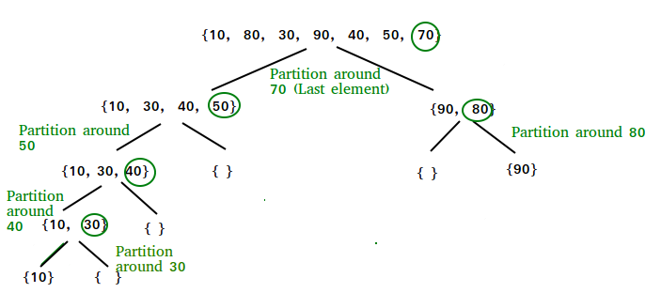
Quick Sort

Slide 5
Quick Sort - Steps
After selecting an element as pivot, which is the last index of the array in our case, we divide the array for the first time.
In quick sort, we call this partitioning. It is not simple breaking down of array into 2 subarrays, but in case of partitioning, the array elements are so positioned that all the elements smaller than the pivot will be on the left side of the pivot and all the elements greater than the pivot will be on the right side of it.
And the pivot element will be at its final sorted position.
The elements to the left and right, may not be sorted.
Then we pick subarrays, elements on the left of pivot and elements on the right of pivot, and we perform partitioning on them by choosing a pivot in the subarrays.

Slide 6
Quick Sort - Steps
partition (arr[], low, high)
{
// pivot (Element to be placed at correct position)
pivot = arr[high];
i = (low - 1) // Index of smaller element
for (j = low; j <= high- 1; j++)
{
// If current element is smaller than or
// equal to pivot
if (arr[j] <= pivot)
{
i++; // increment index of smaller element
swap arr[i] and arr[j]
}
}
swap arr[i + 1] and arr[high])
return (i + 1)
}

Slide 7
Quick Sort - Steps
/* low --> Starting index, high --> Ending index */
quickSort(arr[], low, high)
{
if (low < high)
{
/* pi is partitioning index, arr[pi] is now
at right place */
pi = partition(arr, low, high);
quickSort(arr, low, pi - 1); // Before pi
quickSort(arr, pi + 1, high); // After pi
}
}

Slide 8
Quick Sort

Slide 9
Complexity Analysis of Quick Sort
For an array, in which partitioning leads to unbalanced subarrays, to an extent where on the left side there are no elements, with all the elements greater than the pivot, hence on the right side.
And if keep on getting unbalanced subarrays, then the running time is the worst case, which is O(n2)
Where as if partitioning leads to almost equal subarrays, then the running time is the best, with time complexity as O(n*log n).
Worst Case Time Complexity [ Big-O ]: O(n2)
Best Case Time Complexity [Big-omega]: O(n*log n)
Average Time Complexity [Big-theta]: O(n*log n)

Slide 10
What is a Heap ?
Heap is a special tree-based data structure, that satisfies the following special heap properties:
Shape Property: Heap data structure is always a Complete Binary Tree, which means all levels of the tree are fully filled.
Heap Property: All nodes are either greater than or equal to or less than or equal to each of its children. If the parent nodes are greater than their child nodes, heap is called a Max-Heap, and if the parent nodes are smaller than their child nodes, heap is called Min-Heap.

Slide 11
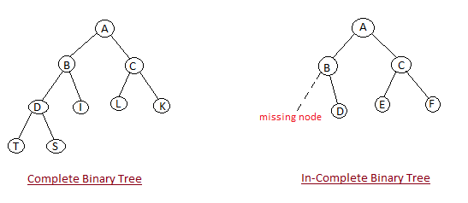
Heap : Shape Property

Slide 12
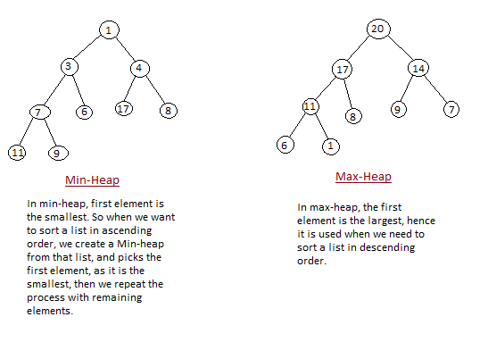
Heap Property

Slide 13
Heap Sort
Involves building a Heap data structure from the given array and then utilizing the Heap to sort the array.

Slide 14
How Heap Sort Works?
Heap sort algorithm is divided into two basic parts:
Creating a Heap of the unsorted list/array.
Then a sorted array is created by repeatedly removing the largest/smallest element from the heap, and inserting it into the array. The heap is reconstructed after each removal.

Slide 15
Heap Sort
Why array based representation for Binary Heap?
Since a Binary Heap is a Complete Binary Tree, it can be easily represented as array and array based representation is space efficient. If the parent node is stored at index I, the left child can be calculated by 2 * I + 1 and right child by 2 * I + 2 (assuming the indexing starts at 0).
How to build the heap ?
Heapify procedure can be applied to a node only if its children nodes are heapified. So the heapification must be performed in the bottom up order.

Slide 16
Complexity Analysis of Heap Sort
Time complexity of heapify is O(Logn). Time complexity of createAndBuildHeap() is O(n) and overall time complexity of Heap Sort is O(nLogn).
Worst Case Time Complexity: O(n*log n)
Best Case Time Complexity: O(n*log n)
Average Time Complexity: O(n*log n)

